Slide 1


Analysis of the connectivity of hydrides within the microstructure of Zr alloys
Research Software Engineering Practice
Group 2
Wunmi Olukoya, Jamie McGregor, Enn Veikesaar and Laura González Duque
03/06/2021
Notes:
Good morning, I’m Laura Gonzalez and I’m going to present the progress of my mini-project, called “The effect of texture on the stress and strain localisation during aluminium sheets bending”, which is being supervised by Joseph Robson and Joao Fonseca

Slide 2
Content
Image processing in Python
Determining connectivity
Testing of the code
Utilisation of git repository
Creation of functions in the code
Written report
Notes:
Aluminium alloys are among the most worldwide demanded alloys and their demand grows every year because they count on many advantageous characteristics, being the principal their low density and low price, especially of interest in the vehicle sector. The European Aluminium association estimated a 40% growth in demand for aluminium between 2019 and 2050. Aluminium sheets are the most popular way of use of this material and they are widely employed in many relevant sectors because they can be cut and formed into different desired shapes. Therefore, there is a strong incentive to optimise the performance of this product and competition in the market is very strong.

Slide 3
Determining connectivity
Notes:
Aluminium alloys are among the most worldwide demanded alloys and their demand grows every year because they count on many advantageous characteristics, being the principal their low density and low price, especially of interest in the vehicle sector. The European Aluminium association estimated a 40% growth in demand for aluminium between 2019 and 2050. Aluminium sheets are the most popular way of use of this material and they are widely employed in many relevant sectors because they can be cut and formed into different desired shapes. Therefore, there is a strong incentive to optimise the performance of this product and competition in the market is very strong.

Slide 4
Utilisation of git repository
Notes:
Aluminium alloys are among the most worldwide demanded alloys and their demand grows every year because they count on many advantageous characteristics, being the principal their low density and low price, especially of interest in the vehicle sector. The European Aluminium association estimated a 40% growth in demand for aluminium between 2019 and 2050. Aluminium sheets are the most popular way of use of this material and they are widely employed in many relevant sectors because they can be cut and formed into different desired shapes. Therefore, there is a strong incentive to optimise the performance of this product and competition in the market is very strong.

Slide 5
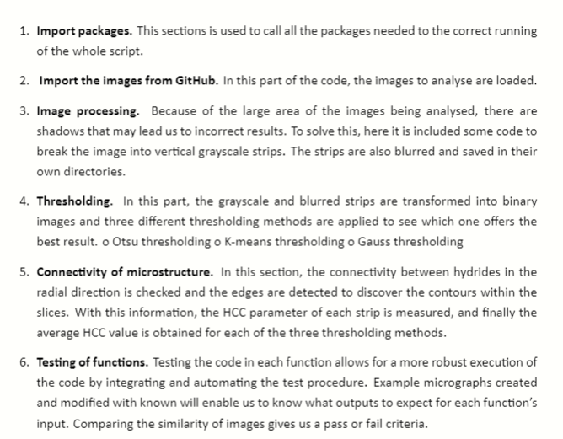
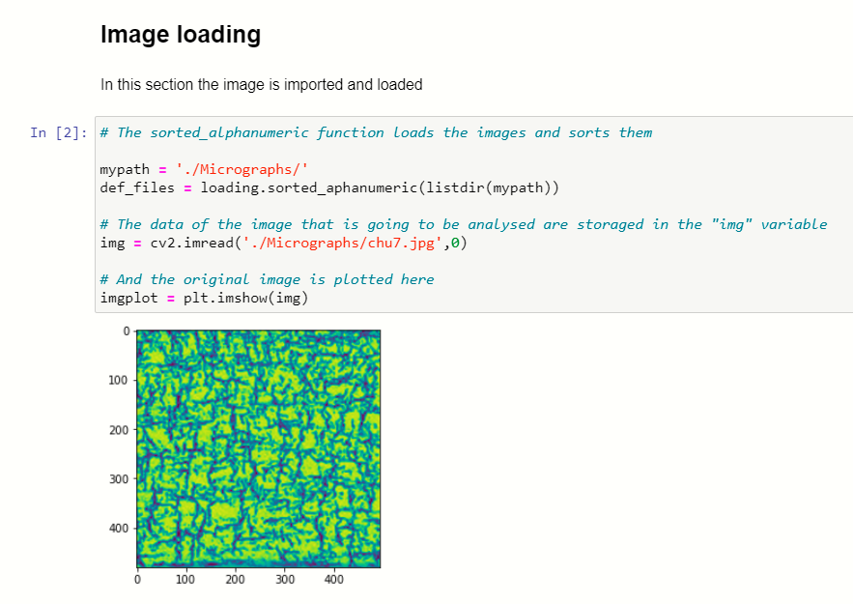
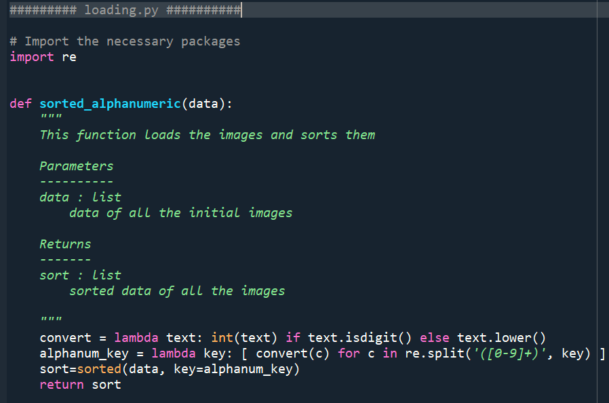
Creation of functions in the code
1
Notes:
Aluminium alloys are among the most worldwide demanded alloys and their demand grows every year because they count on many advantageous characteristics, being the principal their low density and low price, especially of interest in the vehicle sector. The European Aluminium association estimated a 40% growth in demand for aluminium between 2019 and 2050. Aluminium sheets are the most popular way of use of this material and they are widely employed in many relevant sectors because they can be cut and formed into different desired shapes. Therefore, there is a strong incentive to optimise the performance of this product and competition in the market is very strong.

Slide 6
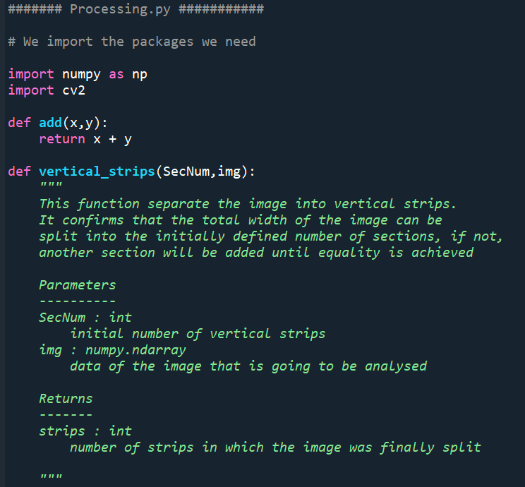
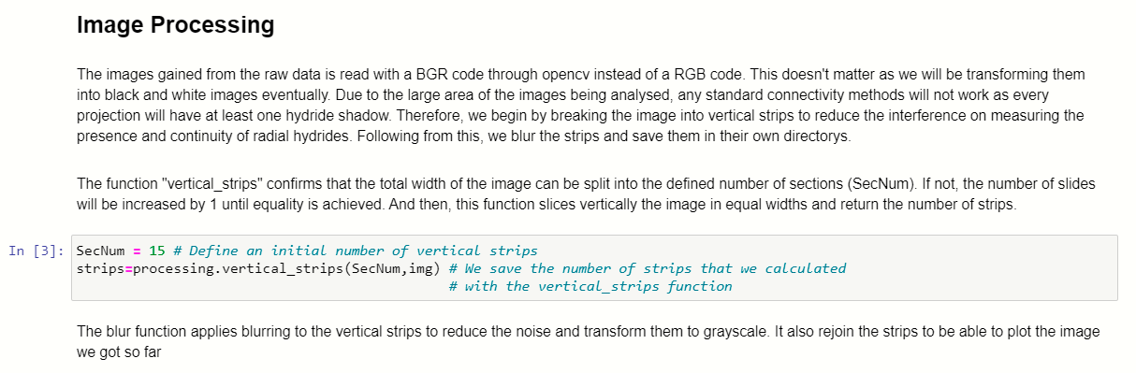
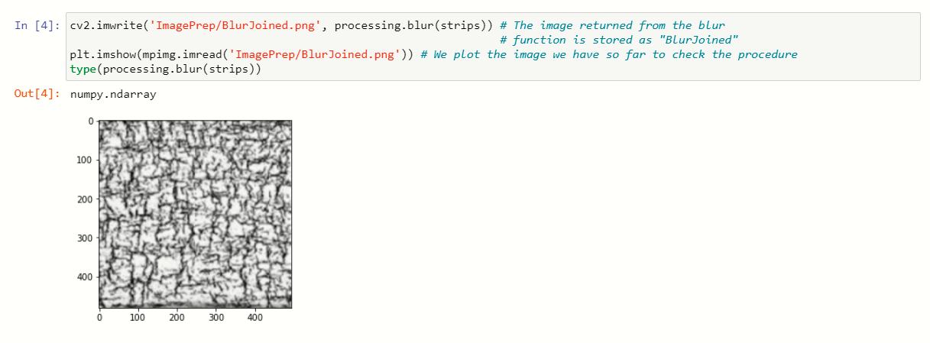
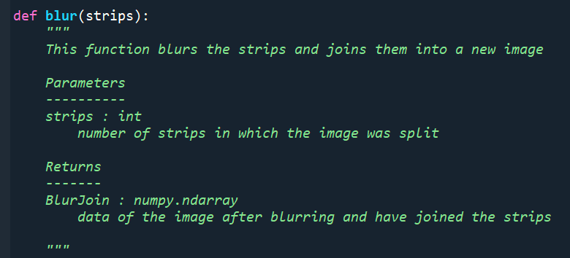
Creation of functions in the code
Notes:
Aluminium alloys are among the most worldwide demanded alloys and their demand grows every year because they count on many advantageous characteristics, being the principal their low density and low price, especially of interest in the vehicle sector. The European Aluminium association estimated a 40% growth in demand for aluminium between 2019 and 2050. Aluminium sheets are the most popular way of use of this material and they are widely employed in many relevant sectors because they can be cut and formed into different desired shapes. Therefore, there is a strong incentive to optimise the performance of this product and competition in the market is very strong.

Slide 7
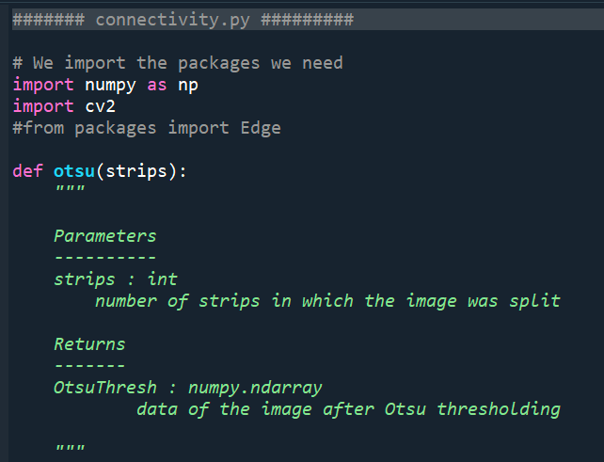
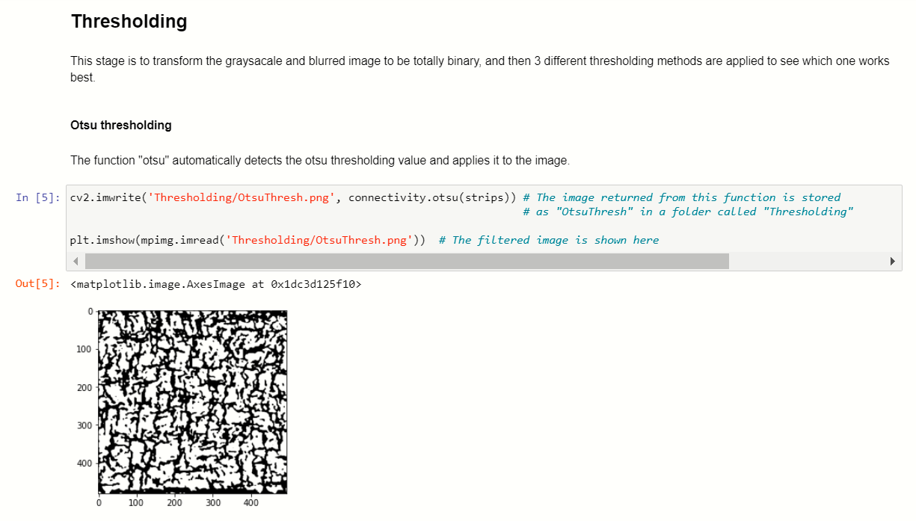
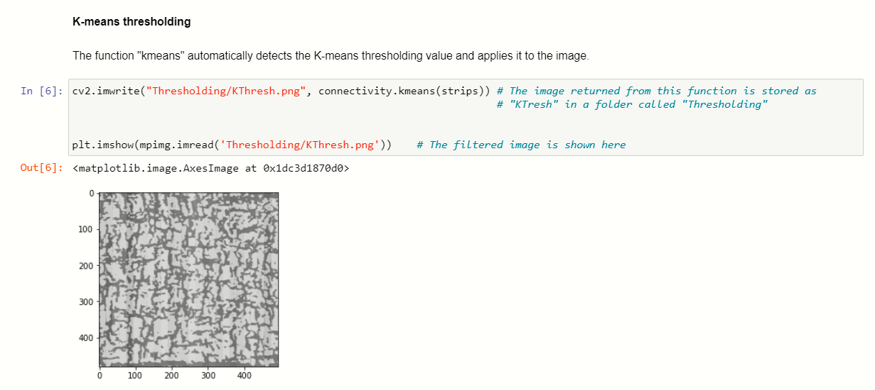
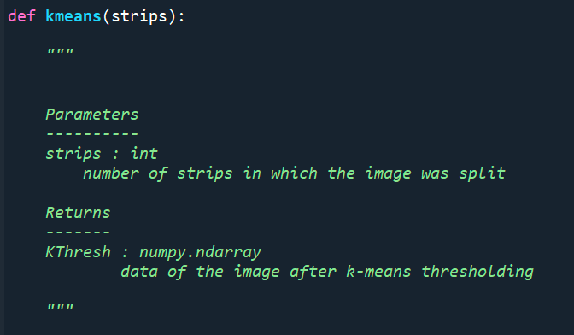
Creation of functions in the code
1
Notes:
Aluminium alloys are among the most worldwide demanded alloys and their demand grows every year because they count on many advantageous characteristics, being the principal their low density and low price, especially of interest in the vehicle sector. The European Aluminium association estimated a 40% growth in demand for aluminium between 2019 and 2050. Aluminium sheets are the most popular way of use of this material and they are widely employed in many relevant sectors because they can be cut and formed into different desired shapes. Therefore, there is a strong incentive to optimise the performance of this product and competition in the market is very strong.

Slide 8
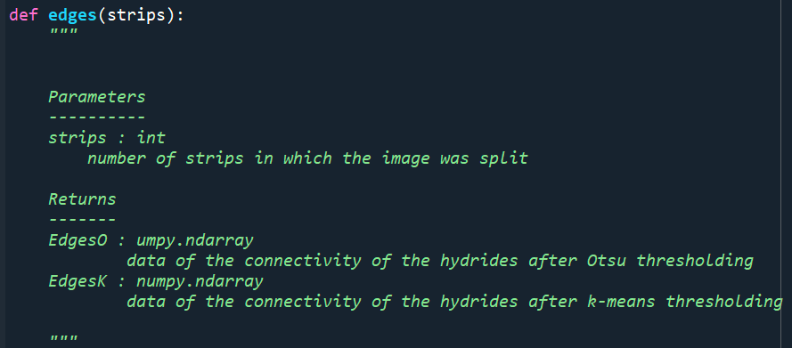
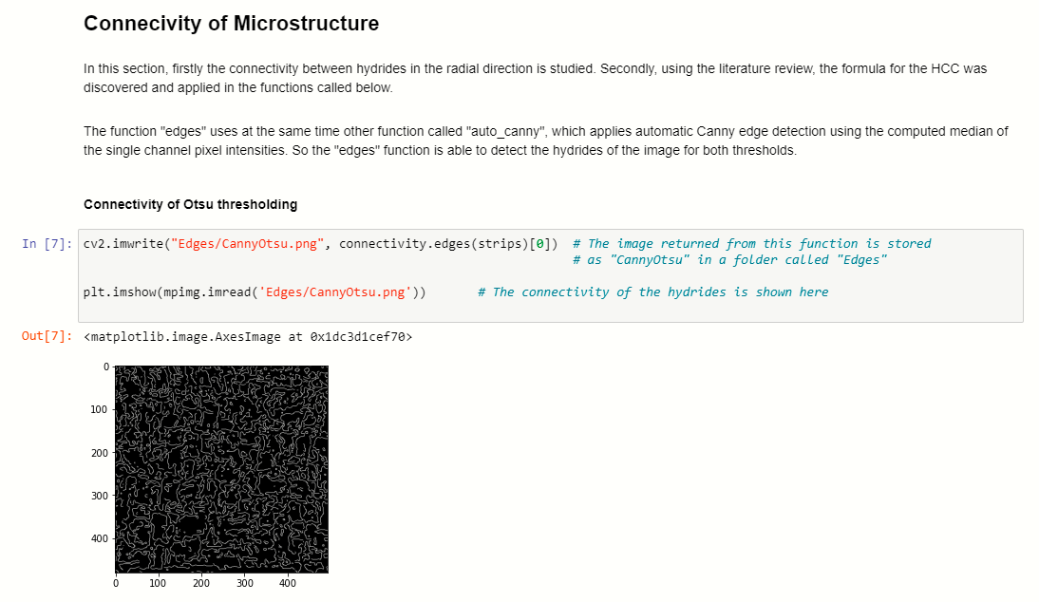
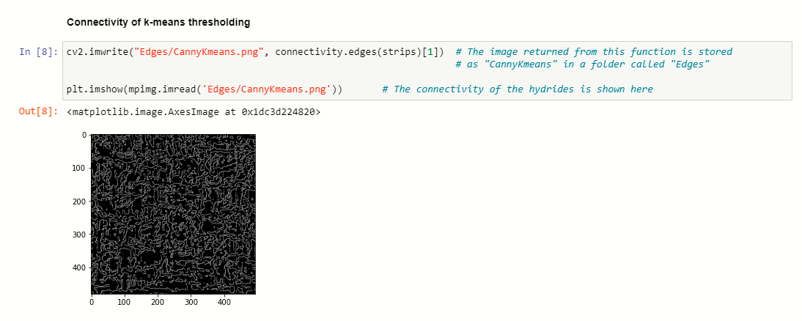
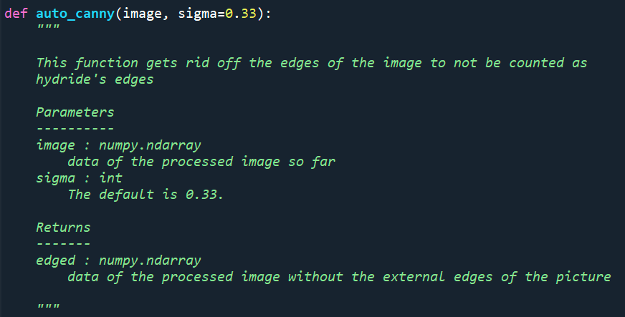
Creation of functions in the code
Notes:
Aluminium alloys are among the most worldwide demanded alloys and their demand grows every year because they count on many advantageous characteristics, being the principal their low density and low price, especially of interest in the vehicle sector. The European Aluminium association estimated a 40% growth in demand for aluminium between 2019 and 2050. Aluminium sheets are the most popular way of use of this material and they are widely employed in many relevant sectors because they can be cut and formed into different desired shapes. Therefore, there is a strong incentive to optimise the performance of this product and competition in the market is very strong.

Slide 9
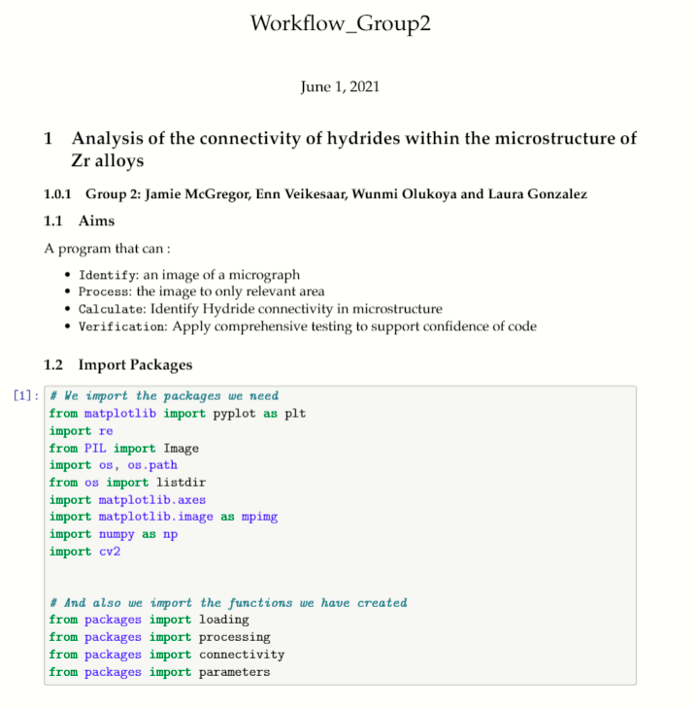
Creation of functions in the code
Structure of the demo notebook
Notes:
Aluminium alloys are among the most worldwide demanded alloys and their demand grows every year because they count on many advantageous characteristics, being the principal their low density and low price, especially of interest in the vehicle sector. The European Aluminium association estimated a 40% growth in demand for aluminium between 2019 and 2050. Aluminium sheets are the most popular way of use of this material and they are widely employed in many relevant sectors because they can be cut and formed into different desired shapes. Therefore, there is a strong incentive to optimise the performance of this product and competition in the market is very strong.

Slide 10

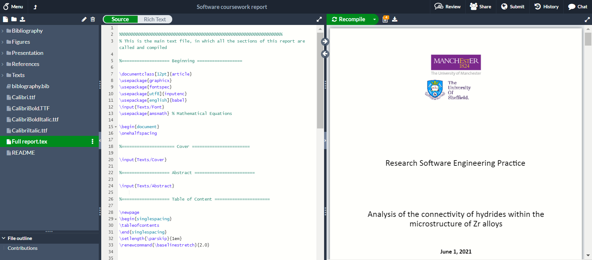
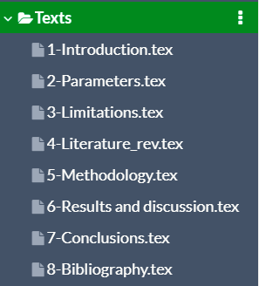
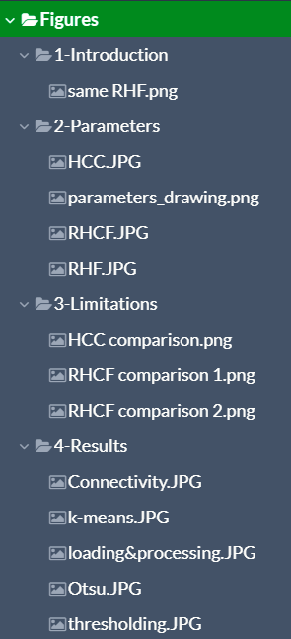
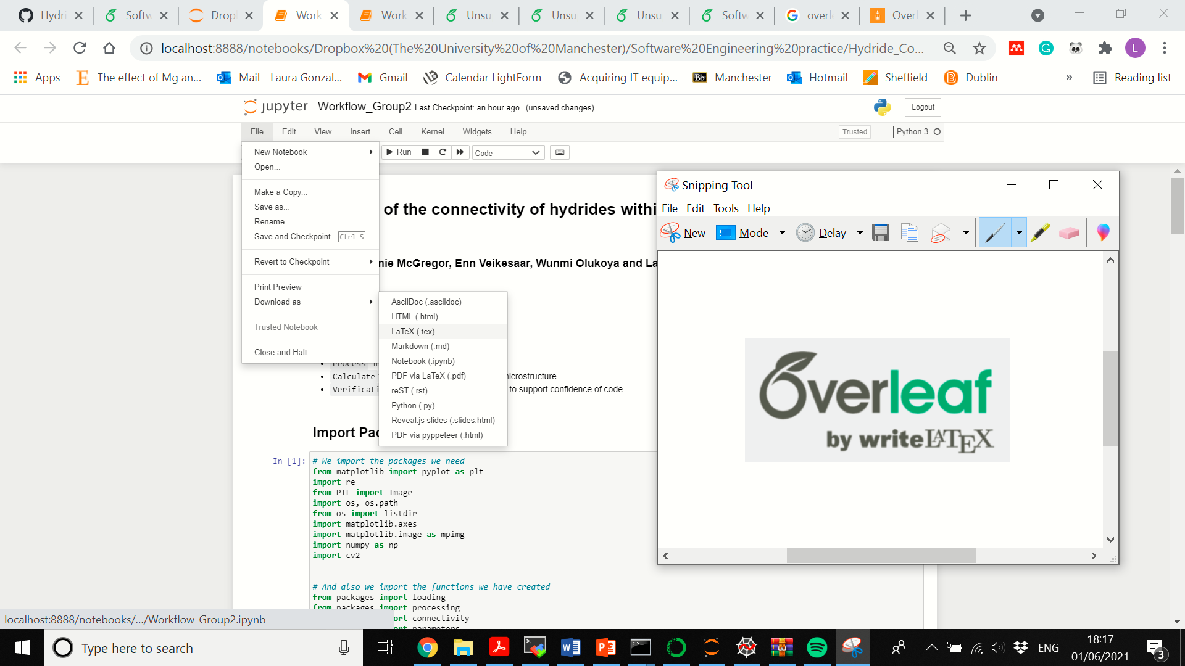
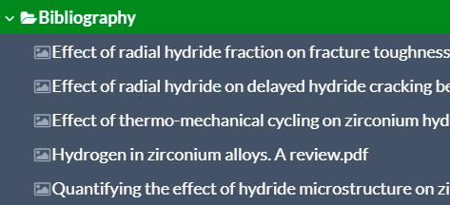
Written report
Overleaf repository for the report:
https://www.overleaf.com/project/605c7f4f07b963c175e28542
Overleaf repository for the notebook:
https://www.overleaf.com/project/60b64f4f49ce6a2fe7bf26a8
Notes:
Aluminium alloys are among the most worldwide demanded alloys and their demand grows every year because they count on many advantageous characteristics, being the principal their low density and low price, especially of interest in the vehicle sector. The European Aluminium association estimated a 40% growth in demand for aluminium between 2019 and 2050. Aluminium sheets are the most popular way of use of this material and they are widely employed in many relevant sectors because they can be cut and formed into different desired shapes. Therefore, there is a strong incentive to optimise the performance of this product and competition in the market is very strong.

Slide 11
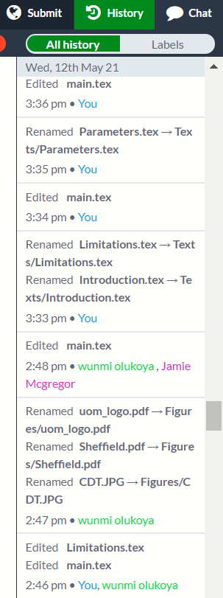
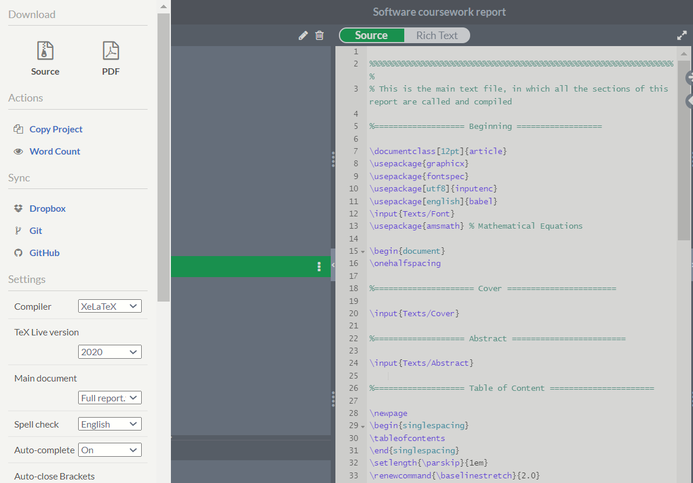

Written report
Notes:
Aluminium alloys are among the most worldwide demanded alloys and their demand grows every year because they count on many advantageous characteristics, being the principal their low density and low price, especially of interest in the vehicle sector. The European Aluminium association estimated a 40% growth in demand for aluminium between 2019 and 2050. Aluminium sheets are the most popular way of use of this material and they are widely employed in many relevant sectors because they can be cut and formed into different desired shapes. Therefore, there is a strong incentive to optimise the performance of this product and competition in the market is very strong.

Slide 12
Thank you

Slide 13





Testing Processing
1.
2.
3.
4.
5.
Choose function to be tested
Set up environment
Define pass/ fail criteria using assert statement
Failed test -
Git outputs a x next to commit
Passing test
Notes:
Testing is a crucial part of python programming , expecially when the program is going to be used by or modified by other people.
A unit test checks a small component in your application
An integration test checks that components in your application operate with each other.
cation.

Slide 14
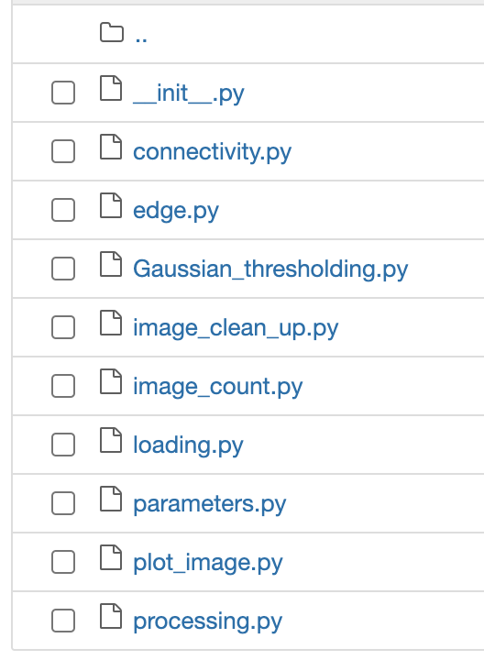
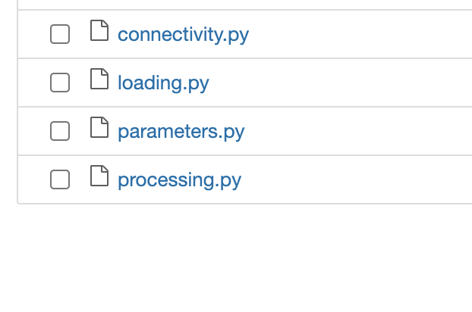
1. Functions to be tested
Notes:
CHoo
A unit test checks a small component in your application
An integration test checks that components in your application operate with each other.
cation.

Slide 15
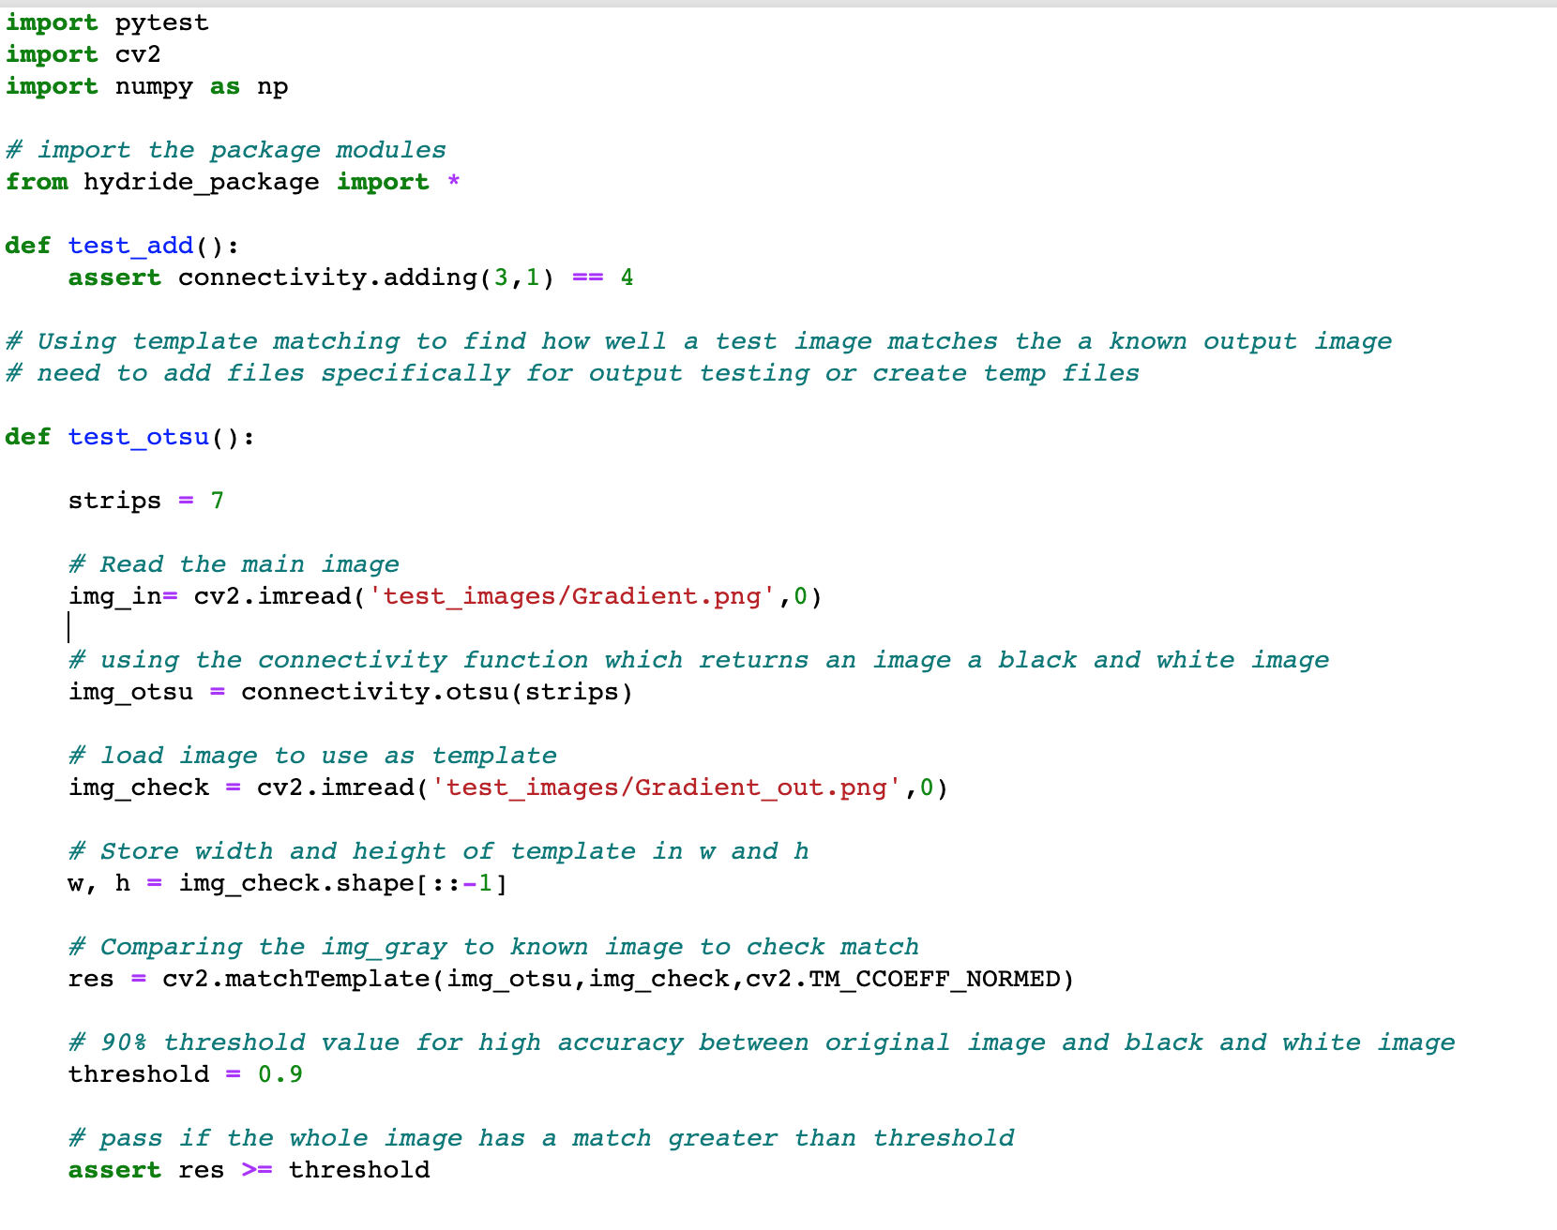


2. Connectivity.otsu
Aim:
Compare an input image to an output image after using the otsu function.
Input
Pass Criteria
To Improve:
Making output image inline with otsu function
Make it work –
Understanding the function better

Slide 16
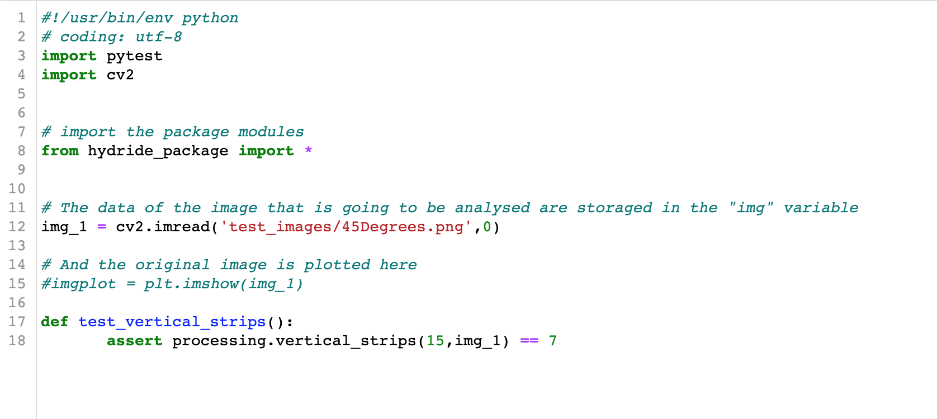

3. Processing.vertical_strips
Aim:
Build a test that that’s a .png file of of a known width and height then compares it to a previously calculated value.
Input
Pass Criteria
== 7
889 png x 500 png

Slide 17


3. Processing.blur
Input
Pass Criteria
Aim:
Test blurring of an input image when passed through Processing.blur
Notes:
Similarity to known output by using a threshold value

Slide 18

3. Parameters.hcc
Aim:
Numerical value for radial hydride that matches known examples.
Input
Pass Criteria
== 0
== 1

Slide 20
Image processing in Python
Notes:
Aluminium alloys are among the most worldwide demanded alloys and their demand grows every year because they count on many advantageous characteristics, being the principal their low density and low price, especially of interest in the vehicle sector. The European Aluminium association estimated a 40% growth in demand for aluminium between 2019 and 2050. Aluminium sheets are the most popular way of use of this material and they are widely employed in many relevant sectors because they can be cut and formed into different desired shapes. Therefore, there is a strong incentive to optimise the performance of this product and competition in the market is very strong.

